Slide 1
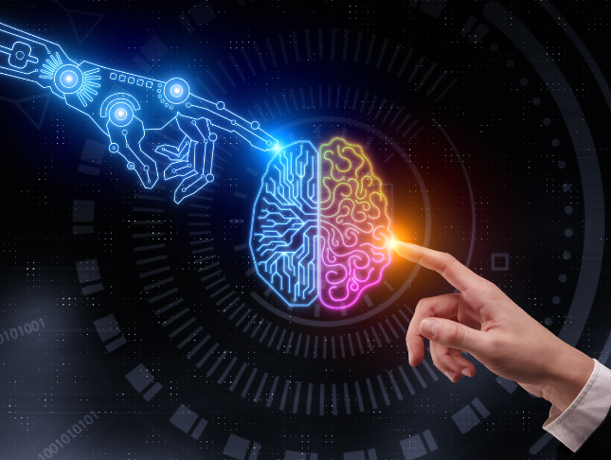
Tutorial 1
﻿Artificial Intelligence and Intelligent Systems
Hongzong Li
Department of Computer Science City University of Hong Kong

Slide 2
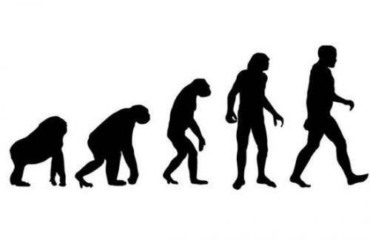
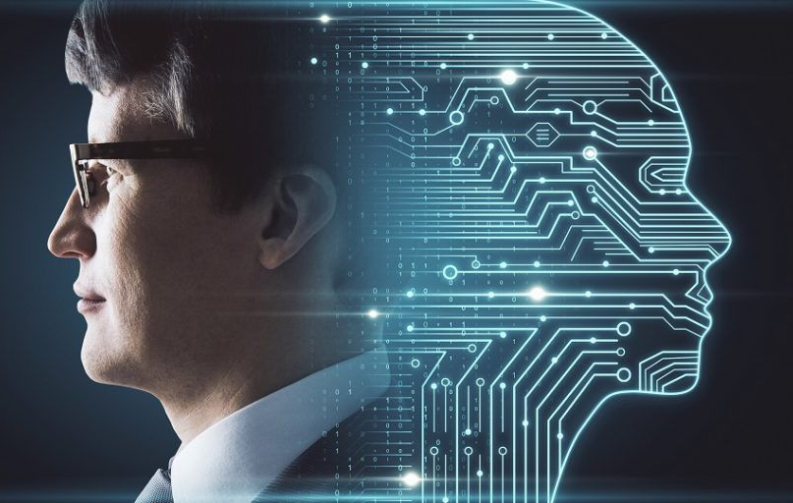
Artificial Intelligence (AI)
What is Intelligence?
Intelligence refers to the ability to learn, adapt, reason, and solve problems.
It can be exhibited by humans, animals, and machines.
Artificial Intelligence (AI)
AI refers to the simulation of human intelligence processes by machines, especially computer systems.
Examples include learning, reasoning, problem-solving, perception, and language understanding.

Slide 3
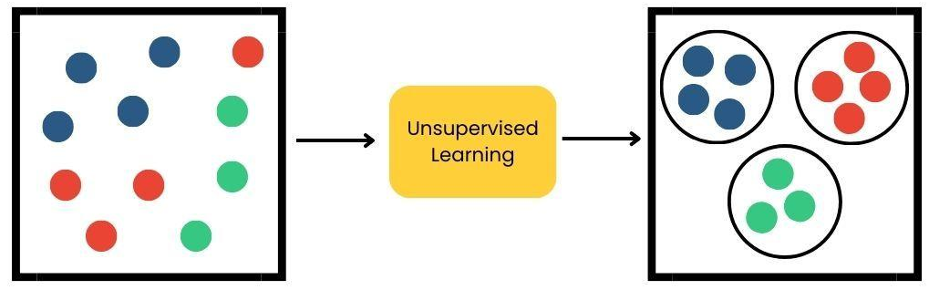
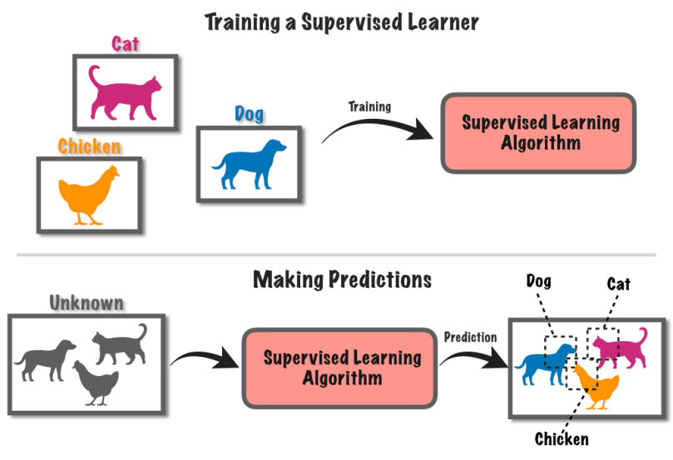
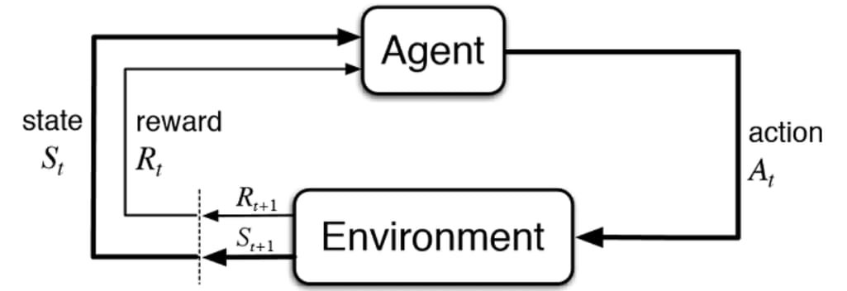
Artificial Intelligence (AI)
Learning
Definition: The ability of AI systems to acquire knowledge or skills from data and improve performance over time.
Types of Learning:
Supervised Learning: Learning from labeled data to map inputs to outputs (e.g., image classification).
Unsupervised Learning: Finding patterns or structures in unlabeled data (e.g., clustering).
Reinforcement Learning: Learning through trial and error using rewards and penalties.
Semi-Supervised Learning: A combination of supervised and unsupervised learning.

Slide 4
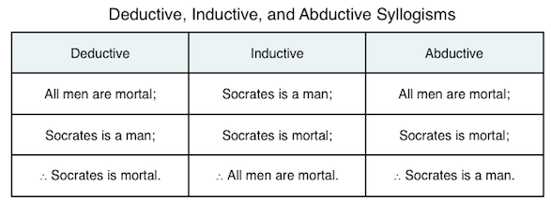
Artificial Intelligence (AI)
Reasoning
Definition: The capability of AI to solve problems and make decisions based on logical deduction or induction.
Key Types:
Deductive Reasoning (演绎): Deriving specific conclusions from general premises (e.g., "All humans are mortal; Socrates is human; therefore, Socrates is mortal").
Inductive Reasoning (归纳): Drawing generalizations from specific observations (e.g., predicting weather based on past patterns).
Abductive Reasoning (溯因): Inferring the most plausible explanation for observed data.
Rules
Circumstances
Results

Slide 5
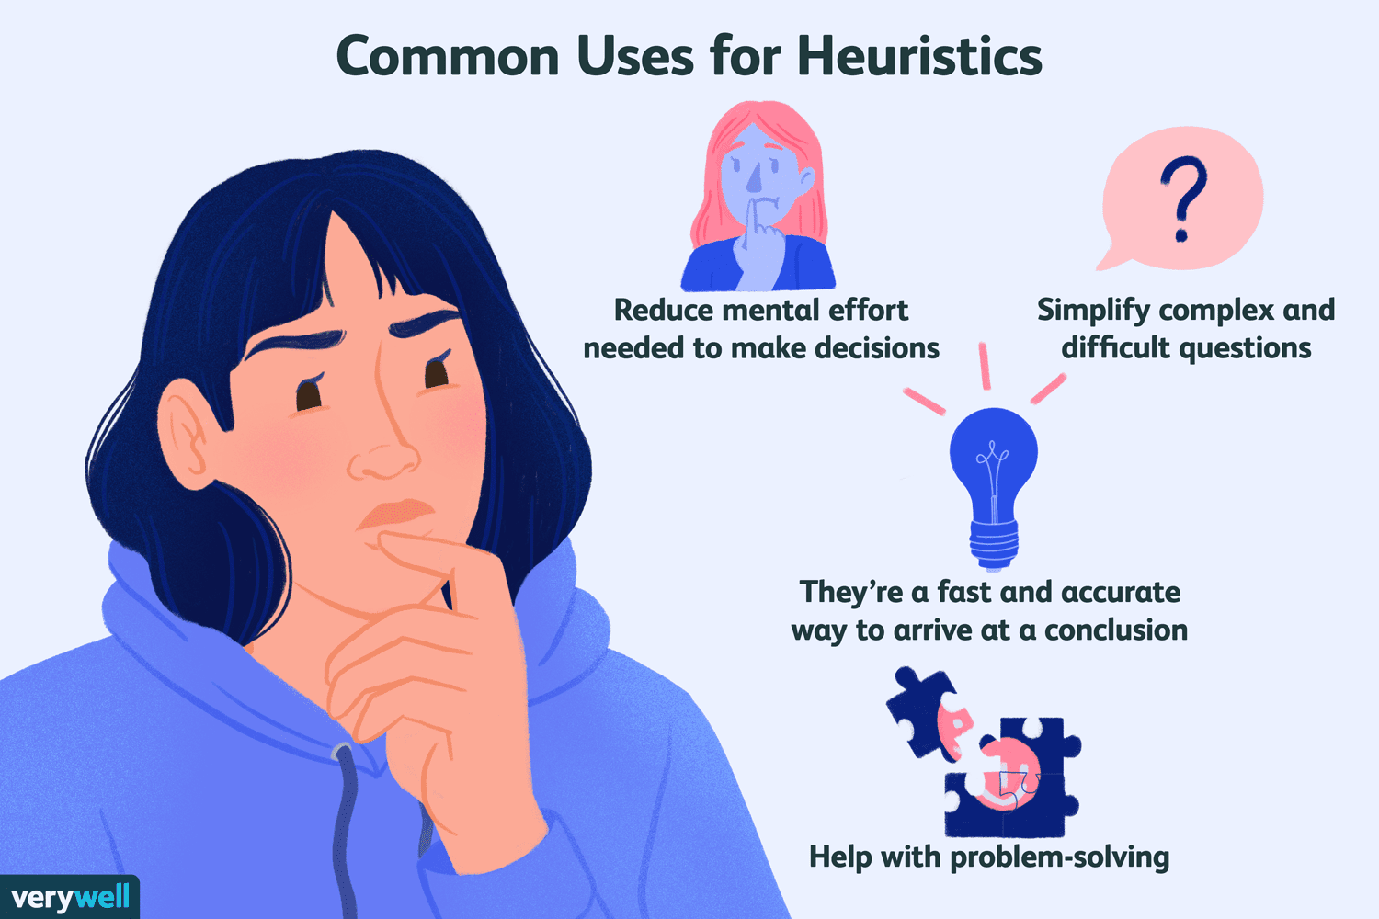
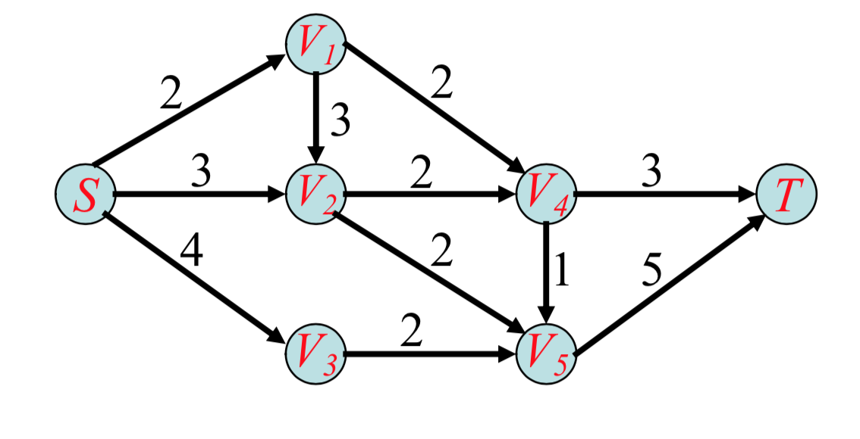
Artificial Intelligence (AI)
Problem-Solving
Definition: The ability of AI to identify and execute a series of steps to achieve a goal or solve a specific challenge.
Approaches:
Search-Based Problem Solving: Exploring possible solutions using algorithms like A* or Dijkstra’s.
Optimization: Finding the best solution based on defined constraints (e.g., linear programming).
Heuristics: Using shortcuts or rules of thumb for quicker solutions.

Slide 6
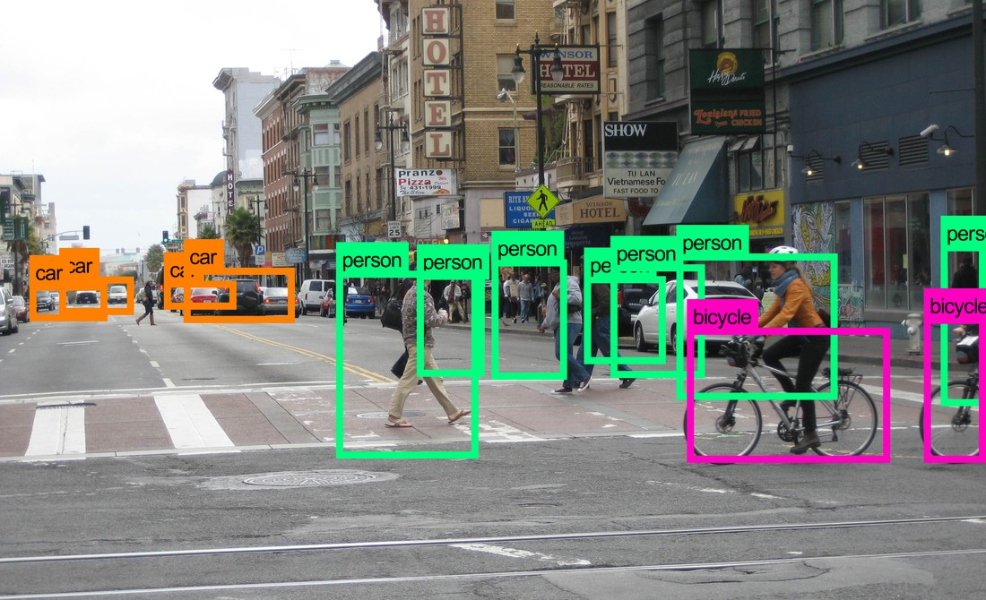
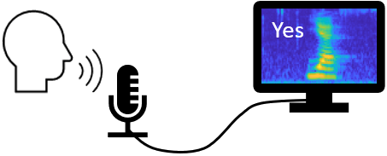
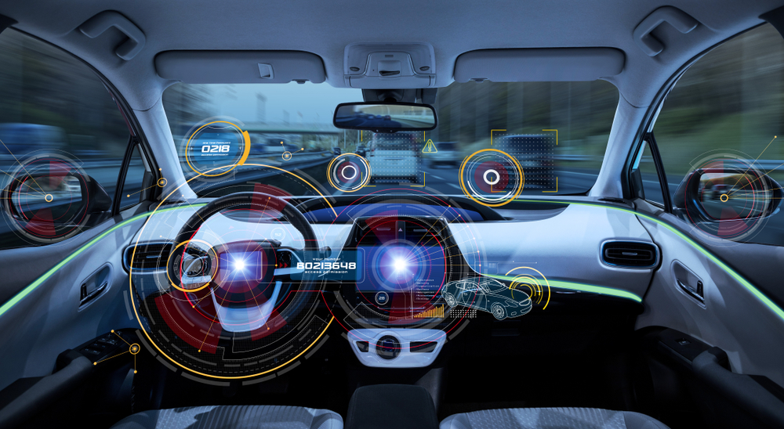
Artificial Intelligence (AI)
Perception
Definition: The ability of AI to process and interpret sensory information from the environment.
Components:
Computer Vision: Interpreting visual data (e.g., recognizing objects, faces, or actions).
Speech Recognition: Converting spoken language into text.
Sensor Data Analysis: Using inputs from cameras, microphones, LiDAR, etc.

Slide 7
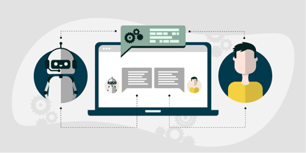
Artificial Intelligence (AI)
Language Understanding
Definition: The ability of AI to comprehend, interpret, and generate human language.
Subfields:
Natural Language Processing (NLP): Involves tasks like tokenization, syntax analysis, and semantic understanding.
Natural Language Understanding (NLU): Focuses on comprehension (e.g., extracting meaning from text).
Natural Language Generation (NLG): Generating human-like text.

Slide 8
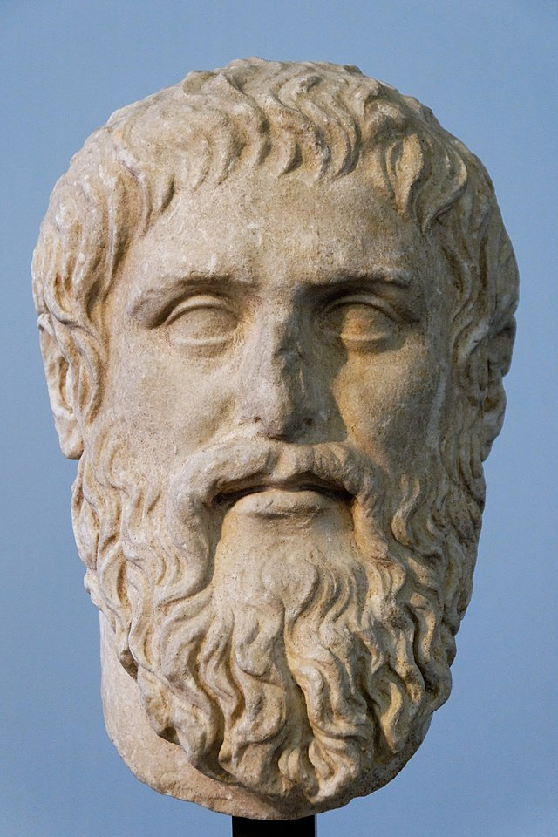
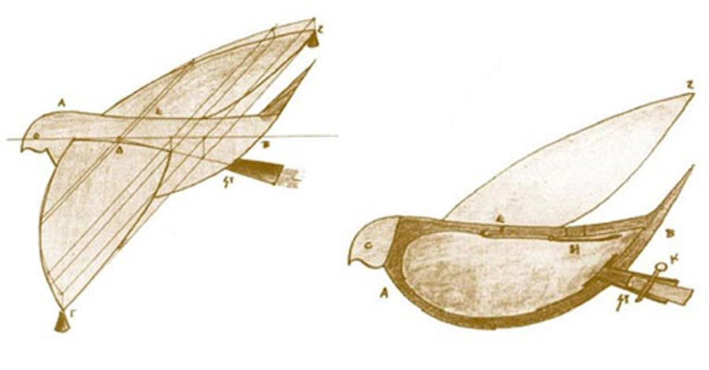
History of Artificial Intelligence (AI)
The idea of “artificial intelligence” goes back thousands of years, to ancient philosophers considering questions of life and death.
In ancient times, inventors made things called “automatons” which were mechanical and moved independently of human intervention. The word “automaton” comes from ancient Greek, and means “acting of one’s own will.” One of the earliest records of an automaton comes from 400 BCE and refers to a mechanical pigeon created by Archytas of Tarentum, a friend of the philosopher Plato.
Notes:
Understand its evolution.
Recognize the milestones that shaped modern AI.

Slide 9
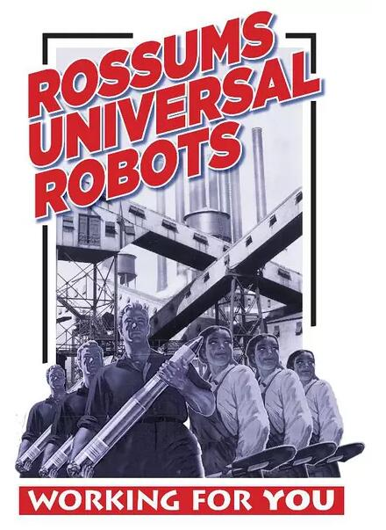
Groundwork for AI
1900-1950, there was a lot of media created that centered around the idea of artificial humans.
So much so that scientists of all sorts started asking the question: is it possible to create an artificial brain? Some creators even made some versions of what we now call “robots” (and the word was coined in a Czech play in 1921) though most of them were relatively simple. These were steam-powered for the most part, and some could make facial expressions and even walk.
1921: Czech playwright Karel Čapek released a science fiction play “Rossum’s Universal Robots” which introduced the idea of “artificial people” which he named robots. This was the first known use of the word.

Slide 10
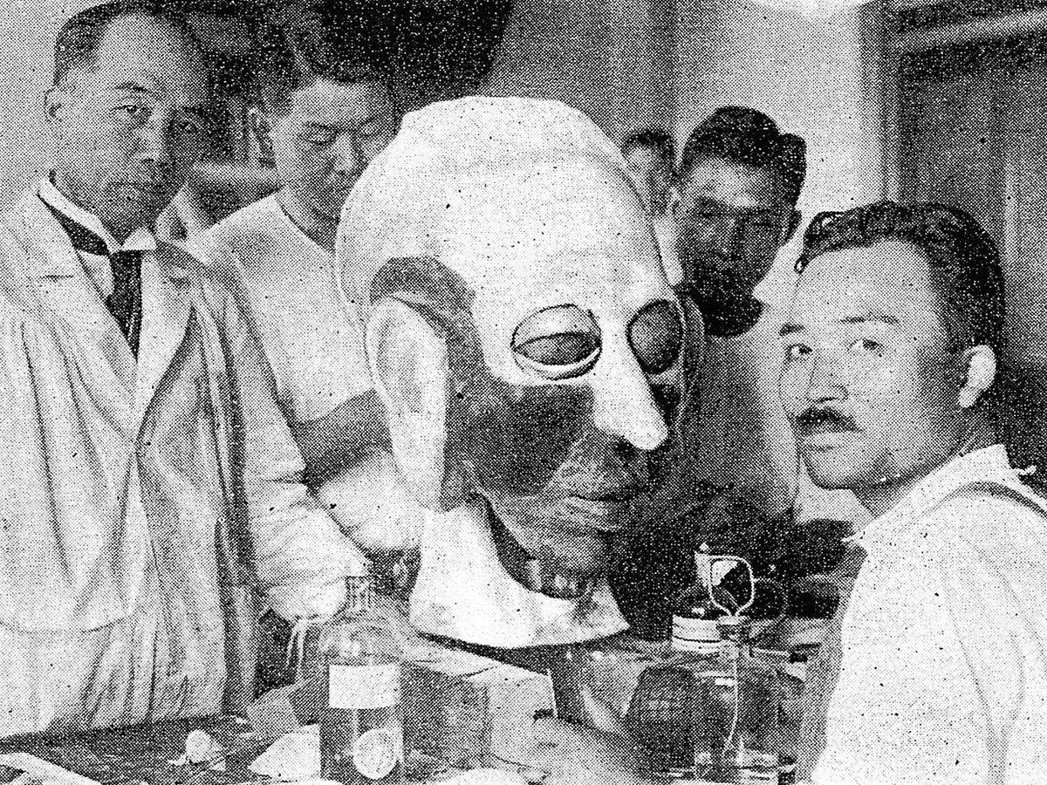
Groundwork for AI
1929: Japanese professor Makoto Nishimura built the first Japanese robot, named Gakutensoku.
1949: Computer scientist Edmund Callis Berkley published the book “Giant Brains, or Machines that Think” which compared the newer models of computers to human brains.
Makoto Nishimura (left) and his team designed Gakutensoku’s head so that it could express human affect.
Notes:
The hard clustering methods may be classified into hierarchical-based, center-based, distribution-based, and density-based clustering algorithms, according to the structure of the algorithms.
Hierarchical-based clustering methods cluster data based on the rule that closer data points exhibit more similarity to each other than the data points lying farther away.
Center-based clustering methods cluster data based on the rule that similarity is derived by the closeness of data to clusters
Distribution-based clustering methods cluster data based on the probability of data belonging to a specific distribution
Density-based clustering methods cluster data based on the density of data points in the feature space

Slide 11
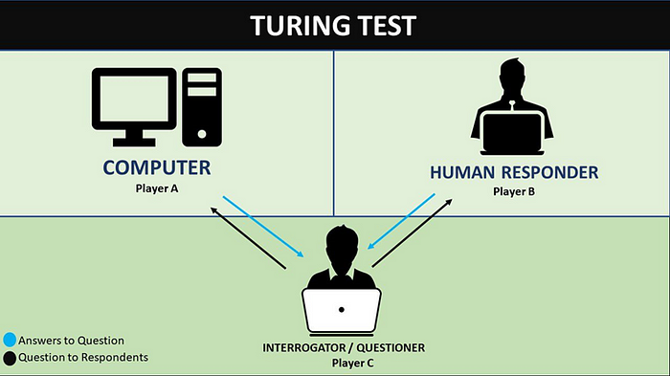
Birth of AI: 1950-1956
This range of time was when the interest in AI really came to a head. Alan Turing published his work “Computer Machinery and Intelligence” which eventually became The Turing Test, which experts used to measure computer intelligence. The term “artificial intelligence” was coined and came into popular use.
1950: Alan Turing published “Computer Machinery and Intelligence” which proposed a test of machine intelligence called The Imitation Game.
The Turing Test
A remote human interrogator, within a fixed time frame, must distinguish between a computer and a human subject based on their replies to various questions posed by the interrogator. By means of a series of such tests, a computer’s success at “thinking” can be measured by its probability of being misidentified as the human subject.
Notes:
The hard clustering methods may be classified into hierarchical-based, center-based, distribution-based, and density-based clustering algorithms, according to the structure of the algorithms.
Hierarchical-based clustering methods cluster data based on the rule that closer data points exhibit more similarity to each other than the data points lying farther away.
Center-based clustering methods cluster data based on the rule that similarity is derived by the closeness of data to clusters
Distribution-based clustering methods cluster data based on the probability of data belonging to a specific distribution
Density-based clustering methods cluster data based on the density of data points in the feature space

Slide 12
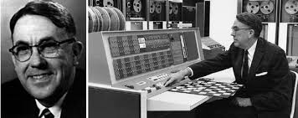
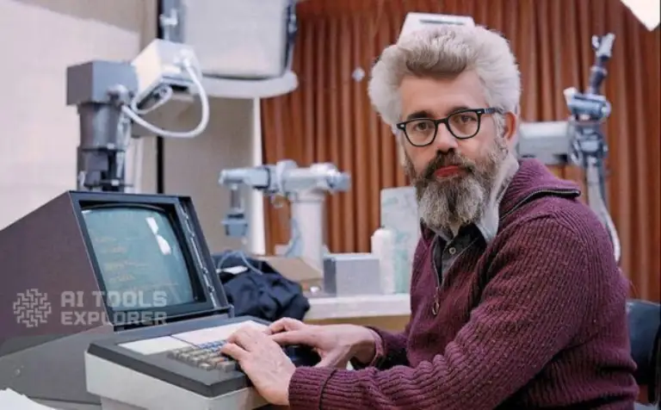
Birth of AI: 1950-1956
1952: A computer scientist named Arthur Samuel developed a program to play checkers, which is the first to ever learn the game independently.
1955: John McCarthy held a workshop at Dartmouth on “artificial intelligence” which is the first use of the word, and how it came into popular usage.
The father of AI

Slide 13
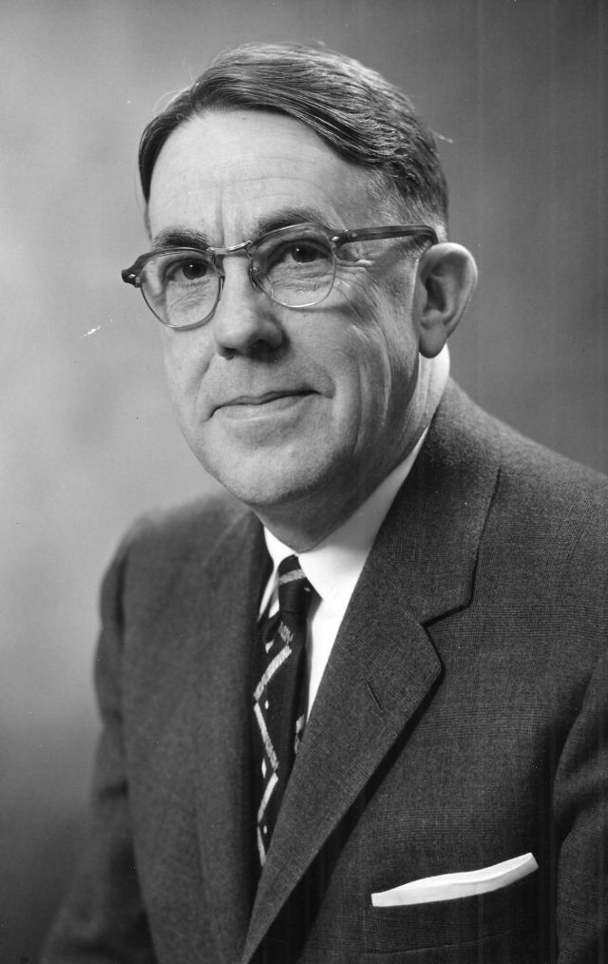
AI maturation: 1957-1979
The time between when the phrase “artificial intelligence” was created, and the 1980s was a period of both rapid growth and struggle for AI research. The late 1950s through the 1960s was a time of creation. From programming languages that are still in use to this day to books and films that explored the idea of robots, AI became a mainstream idea quickly.
The 1970s showed similar improvements, such as the first anthropomorphic robot being built in Japan, to the first example of an autonomous vehicle being built by an engineering grad student. However, it was also a time of struggle for AI research, as the U.S. government showed little interest in continuing to fund AI research.
1958: John McCarthy created LISP (acronym for List Processing), the first programming language for AI research, which is still in popular use to this day.
1959: Arthur Samuel created the term “machine learning” when doing a speech about teaching machines to play chess better than the humans who programmed them.
Arthur Samuel: Pioneer in Machine Learning

Slide 14
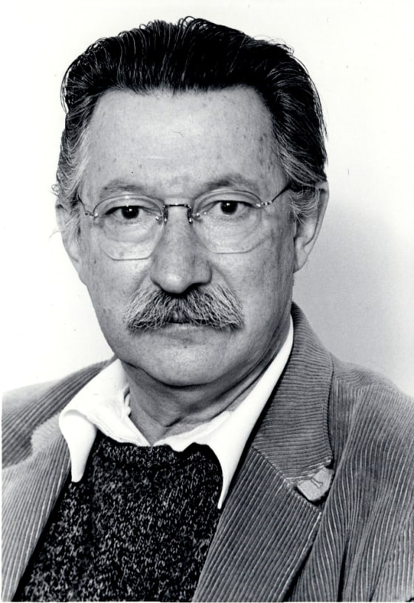
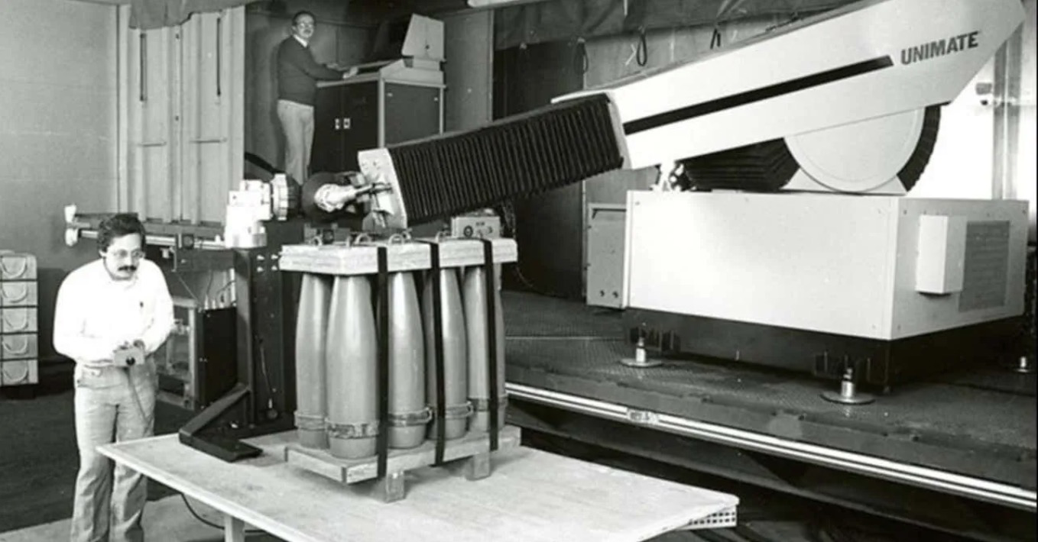
AI maturation: 1957-1979
1961: The first industrial robot Unimate started working on an assembly line at General Motors in New Jersey, tasked with transporting die casings and welding parts on cars (which was deemed too dangerous for humans).
1965: Edward Feigenbaum and Joshua Lederberg created the first “expert system” which was a form of AI programmed to replicate the thinking and decision-making abilities of human experts.
1966: Joseph Weizenbaum created the first “chatterbot” (later shortened to chatbot), ELIZA, a mock psychotherapist, that used natural language processing (NLP) to converse with humans.
Joseph Weizenbaum

Slide 15
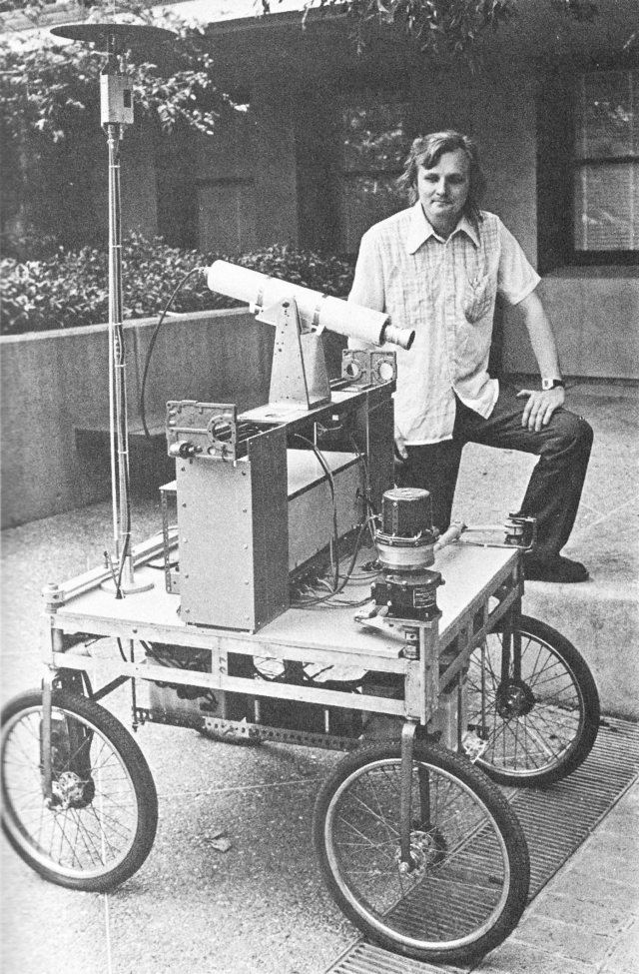
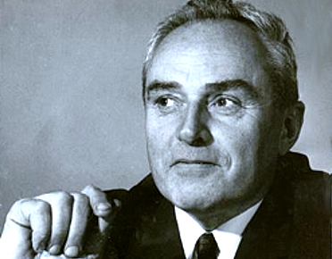
AI maturation: 1957-1979
1968: Soviet mathematician Alexey Ivakhnenko published “Group Method of Data Handling” in the journal “Avtomatika,” which proposed a new approach to AI that would later become what we now know as “Deep Learning.”
1973: An applied mathematician named James Lighthill gave a report to the British Science Council, underlining that strides were not as impressive as those that had been promised by scientists, which led to much-reduced support and funding for AI research from the British government.
1979: James L. Adams created The Standford Cart in 1961, which became one of the first examples of an autonomous vehicle. In ‘79, it successfully navigated a room full of chairs without human interference.

Slide 16

AI boom: 1980-1987
Most of the 1980s showed a period of rapid growth and interest in AI, now labeled as the “AI boom.” This came from both breakthroughs in research, and additional government funding to support the researchers. Deep Learning techniques and the use of Expert System became more popular, both of which allowed computers to learn from their mistakes and make independent decisions.
1980: First conference of the AAAI was held at Stanford.
1980: The first expert system came into the commercial market, known as XCON (expert configurer). It was designed to assist in the ordering of computer systems by automatically picking components based on the customer’s needs.
Notes:
The hard clustering methods may be classified into hierarchical-based, center-based, distribution-based, and density-based clustering algorithms, according to the structure of the algorithms.
Hierarchical-based clustering methods cluster data based on the rule that closer data points exhibit more similarity to each other than the data points lying farther away.
Center-based clustering methods cluster data based on the rule that similarity is derived by the closeness of data to clusters
Distribution-based clustering methods cluster data based on the probability of data belonging to a specific distribution
Density-based clustering methods cluster data based on the density of data points in the feature space

Slide 17
AI boom: 1980-1987
1981: The Japanese government allocated $850 million (over $2 billion dollars in today’s money) to the Fifth Generation Computer project. Their aim was to create computers that could translate, converse in human language, and express reasoning on a human level.
1984: The AAAI warns of an incoming “AI Winter” where funding and interest would decrease, and make research significantly more difficult.
1985: An autonomous drawing program known as AARON is demonstrated at the AAAI conference.
1986: Ernst Dickmann and his team at Bundeswehr University of Munich created and demonstrated the first driverless car (or robot car). It could drive up to 55 mph on roads that didn’t have other obstacles or human drivers.
1987: Commercial launch of Alacrity by Alactrious Inc. Alacrity was the first strategy managerial advisory system, and used a complex expert system with 3,000+ rules.

Slide 18
AI winter: 1987-1993
As the AAAI warned, an AI Winter came. The term describes a period of low consumer, public, and private interest in AI which leads to decreased research funding, which, in turn, leads to few breakthroughs. Both private investors and the government lost interest in AI and halted their funding due to high cost versus seemingly low return. This AI Winter came about because of some setbacks in the machine market and expert systems, including the end of the Fifth Generation project, cutbacks in strategic computing initiatives, and a slowdown in the deployment of expert systems.
1987: The market for specialized LISP-based hardware collapsed due to cheaper and more accessible competitors that could run LISP software, including those offered by IBM and Apple. This caused many specialized LISP companies to fail as the technology was now easily accessible.
1988: A computer programmer named Rollo Carpenter invented the chatbot Jabberwacky, which he programmed to provide interesting and entertaining conversation to humans.

Slide 19
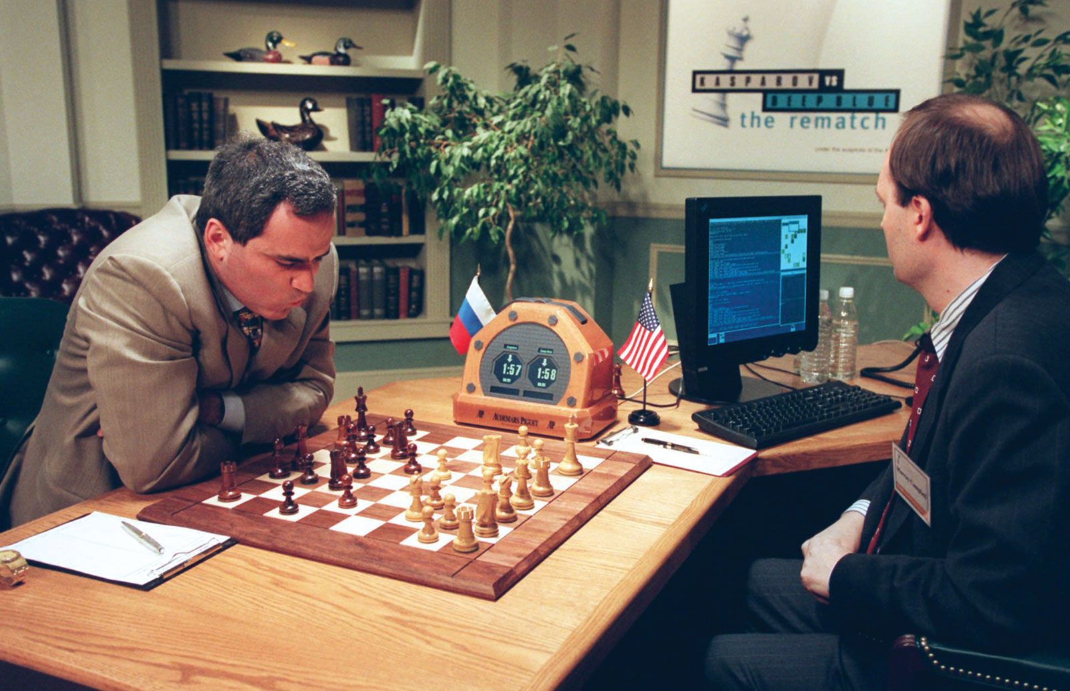
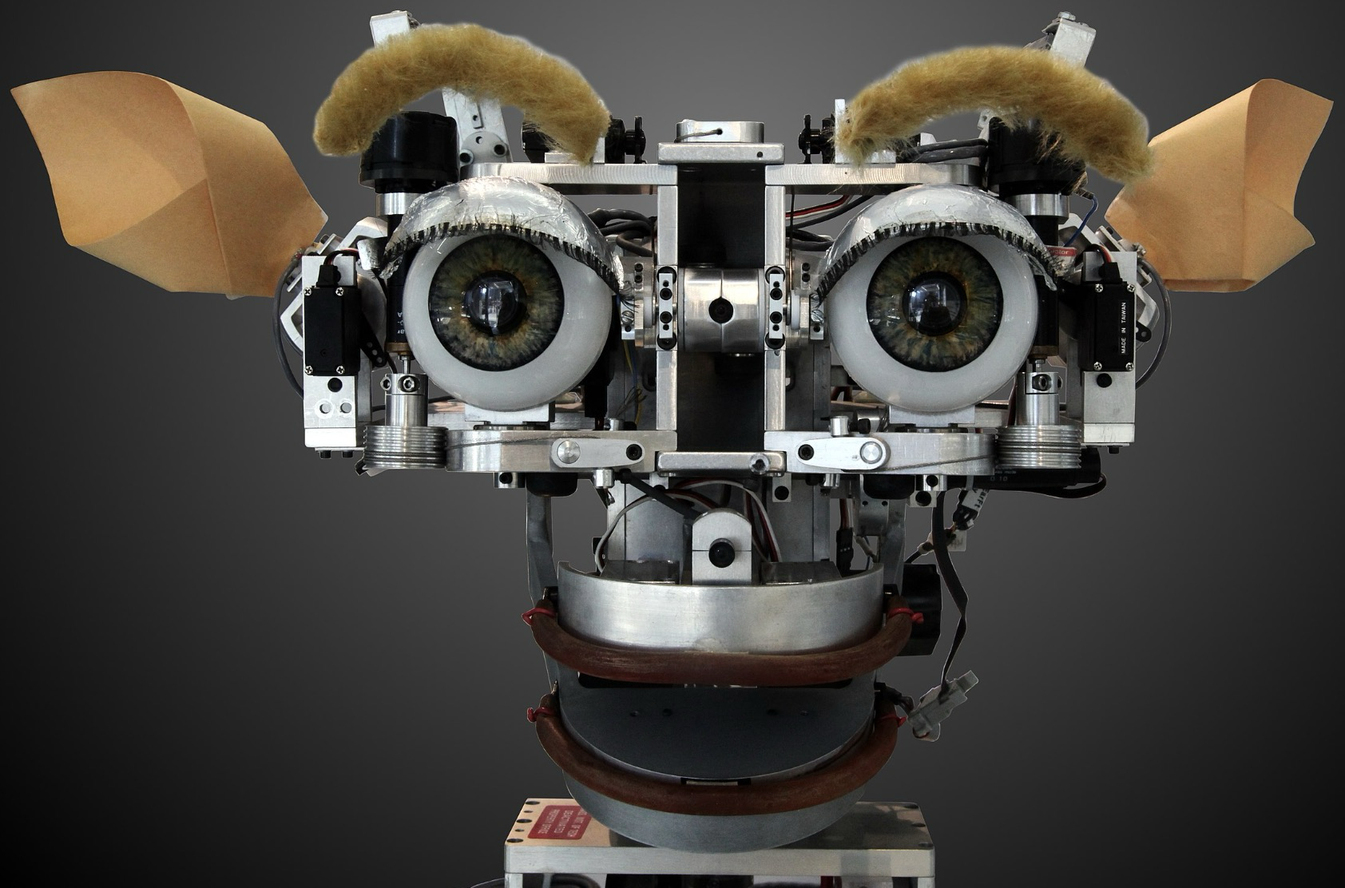
AI agents: 1993-2011
Despite the lack of funding during the AI Winter, the early 90s showed some impressive strides forward in AI research, including the introduction of the first AI system that could beat a reigning world champion chess player. This era also introduced AI into everyday life via innovations such as the first Roomba and the first commercially-available speech recognition software on Windows computers. The surge in interest was followed by a surge in funding for research, which allowed even more progress to be made.
1997: Deep Blue (developed by IBM) beat the world chess champion, Gary Kasparov, in a highly-publicized match, becoming the first program to beat a human chess champion.
2000: Professor Cynthia Breazeal developed the first robot that could simulate human emotions with its face,which included eyes, eyebrows, ears, and a mouth. It was called Kismet.

Slide 20
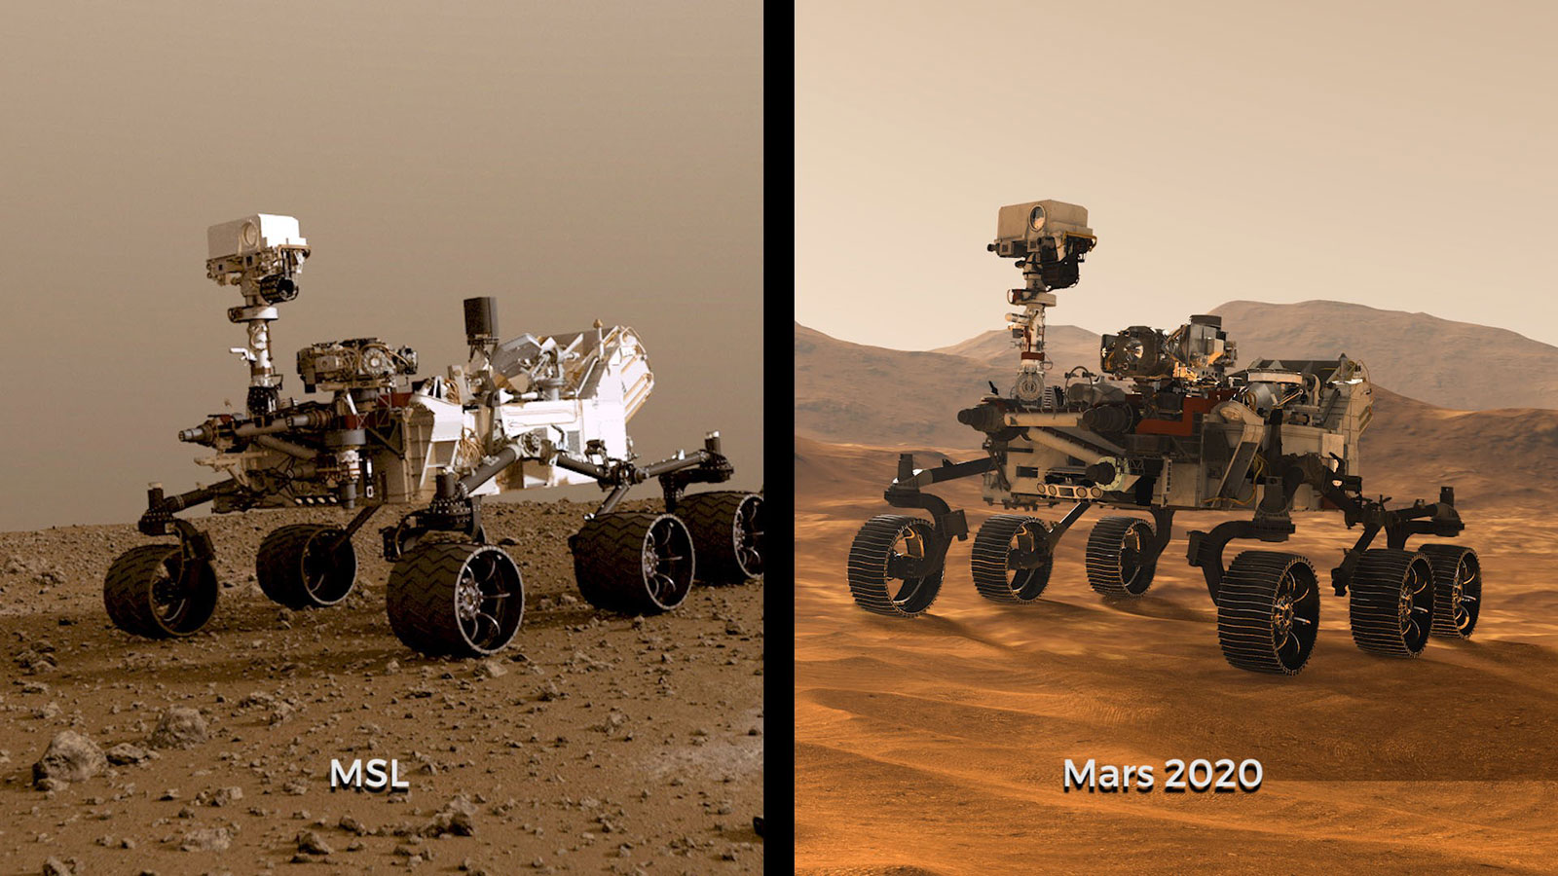
AI agents: 1993-2011
.
2003: NASA landed two rovers onto Mars (Spirit and Opportunity) and they navigated the surface of the planet without human intervention.
2006: Companies such as Twitter, Facebook, and Netflix started utilizing AI as a part of their advertising and user experience (UX) algorithms.
2010: Microsoft launched the Xbox 360 Kinect, the first gaming hardware designed to track body movement and translate it into gaming directions.
2011: An NLP computer programmed to answer questions named Watson (created by IBM) won Jeopardy against two former champions in a televised game.
2011: Apple released Siri, the first popular virtual assistant.
Notes:
The hard clustering methods may be classified into hierarchical-based, center-based, distribution-based, and density-based clustering algorithms, according to the structure of the algorithms.
Hierarchical-based clustering methods cluster data based on the rule that closer data points exhibit more similarity to each other than the data points lying farther away.
Center-based clustering methods cluster data based on the rule that similarity is derived by the closeness of data to clusters
Distribution-based clustering methods cluster data based on the probability of data belonging to a specific distribution
Density-based clustering methods cluster data based on the density of data points in the feature space

Slide 21
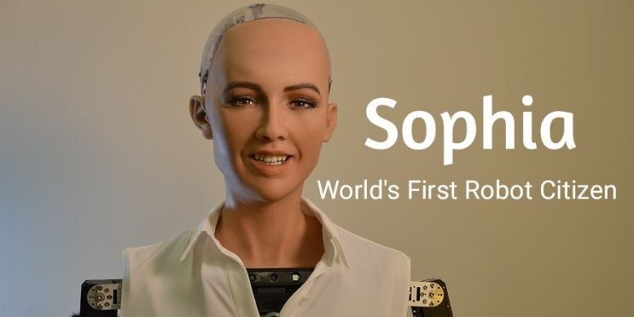
Artificial General Intelligence: 2012-present
That brings us to the most recent developments in AI, up to the present day. We’ve seen a surge in common-use AI tools, such as virtual assistants, search engines, etc. This time period also popularized Deep Learning and Big Data.
2012: Two researchers from Google (Jeff Dean and Andrew Ng) trained a neural network to recognize cats by showing it unlabeled images and no background information.
2015: Elon Musk, Stephen Hawking, and Steve Wozniak (and over 3,000 others) signed an open letter to the worlds’ government systems banning the development of (and later, use of) autonomous weapons for purposes of war.
2016: Hanson Robotics created a humanoid robot named Sophia, who became known as the first “robot citizen” and was the first robot created with a realistic human appearance and the ability to see and replicate emotions, as well as to communicate.
Notes:
The hard clustering methods may be classified into hierarchical-based, center-based, distribution-based, and density-based clustering algorithms, according to the structure of the algorithms.
Hierarchical-based clustering methods cluster data based on the rule that closer data points exhibit more similarity to each other than the data points lying farther away.
Center-based clustering methods cluster data based on the rule that similarity is derived by the closeness of data to clusters
Distribution-based clustering methods cluster data based on the probability of data belonging to a specific distribution
Density-based clustering methods cluster data based on the density of data points in the feature space

Slide 22
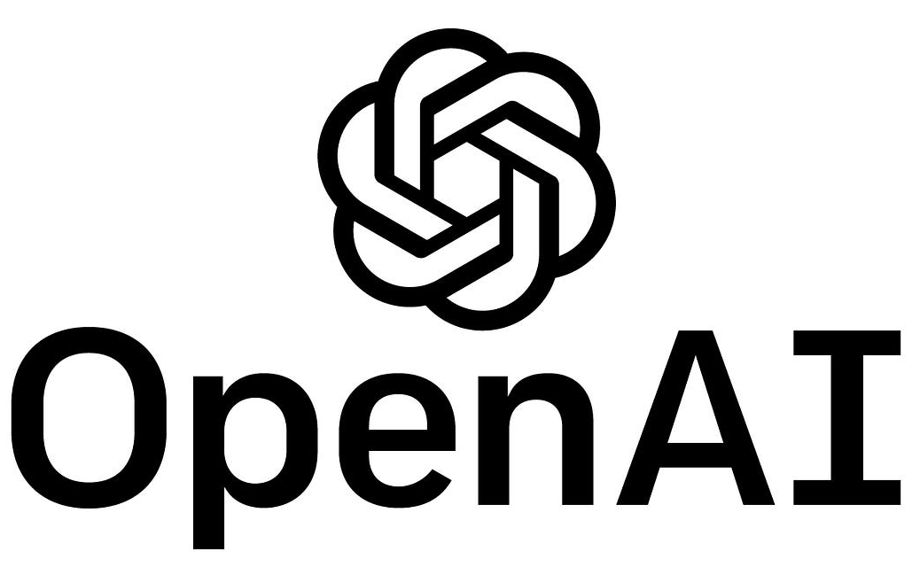
Artificial General Intelligence: 2012-present
2017: Facebook programmed two AI chatbots to converse and learn how to negotiate, but as they went back and forth they ended up forgoing English and developing their own language, completely autonomously.
2018: A Chinese tech group called Alibaba’s language-processing AI beat human intellect on a Stanford reading and comprehension test.
2019: Google’s AlphaStar reached Grandmaster on the video game StarCraft 2, outperforming all but .2% of human players.
2020: OpenAI started beta testing GPT-3, a model that uses Deep Learning to create code, poetry, and other such language and writing tasks. While not the first of its kind, it is the first that creates content almost indistinguishable from those created by humans.
2021: OpenAI developed DALL-E, which can process and understand images enough to produce accurate captions, moving AI one step closer to understanding the visual world.

Slide 23

What is an Intelligent System?
Systems that use AI to adapt to new situations, make decisions, and solve problems.
They often mimic cognitive functions like decision-making, planning, and learning.
Notes:
The hard clustering methods may be classified into hierarchical-based, center-based, distribution-based, and density-based clustering algorithms, according to the structure of the algorithms.
Hierarchical-based clustering methods cluster data based on the rule that closer data points exhibit more similarity to each other than the data points lying farther away.
Center-based clustering methods cluster data based on the rule that similarity is derived by the closeness of data to clusters
Distribution-based clustering methods cluster data based on the probability of data belonging to a specific distribution
Density-based clustering methods cluster data based on the density of data points in the feature space

Slide 24
Intelligent System and AI Agent
Aspect | AI Agent | Intelligent System
Definition | An entity that perceives and acts within an environment. | A system involving multiple components, including agents, that solve complex tasks.
Scope | Focused on individual behavior and decision-making. | Broader, with multiple agents and additional components.
Components | Perception, action, decision-making, learning. | Multiple agents, coordination mechanisms, reasoning, and learning.
an AI agent is a fundamental part of an intelligent system, but an intelligent system is more complex, often involving coordination between multiple agents and additional components to tackle broader challenges.

Slide 25

Examples of Intelligent Systems
Transportation
Traffic control systems, traffic flow analysis and congestion monitoring, delivery fleet coordination, autonomous cars, public transportation systems, accident prevention

Slide 26
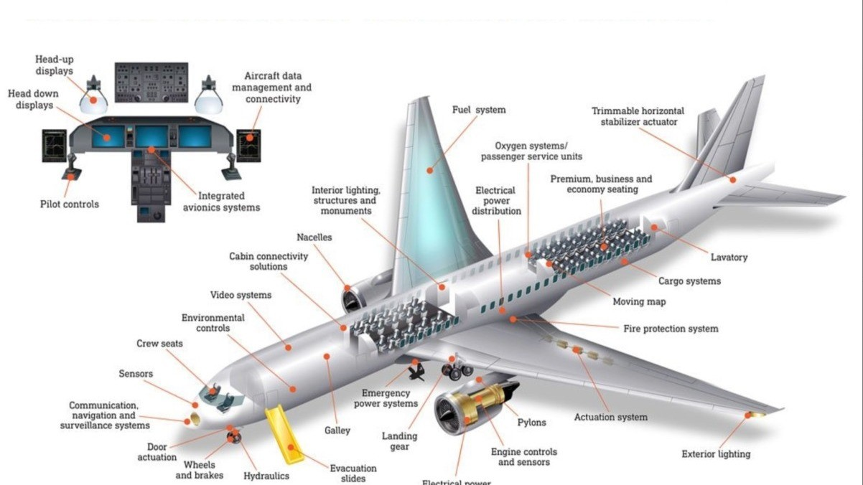
Examples of Intelligent Systems
Aerospace
Airline cockpit controls, drones, spacecraft monitoring, mission planning, advanced guidance and navigation, air traffic control

Slide 27
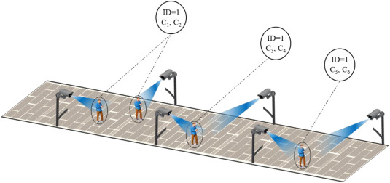
Examples of Intelligent Systems
Human identification
Visual surveillance, biometric monitoring (such as face or fingerprint recognition), character or speech recognition

Slide 28
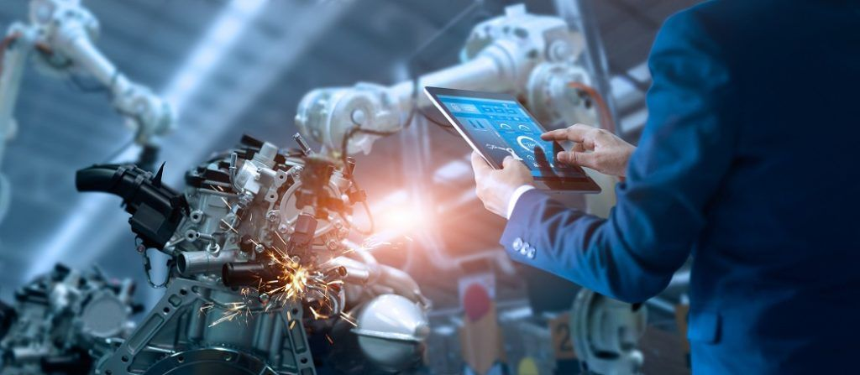
Examples of Intelligent Systems
Manufacturing
Advanced robotics and automation, autonomous systems, diagnostics and repairs, inventory management, visual inspection

Slide 29
Thanks

